Slide 1

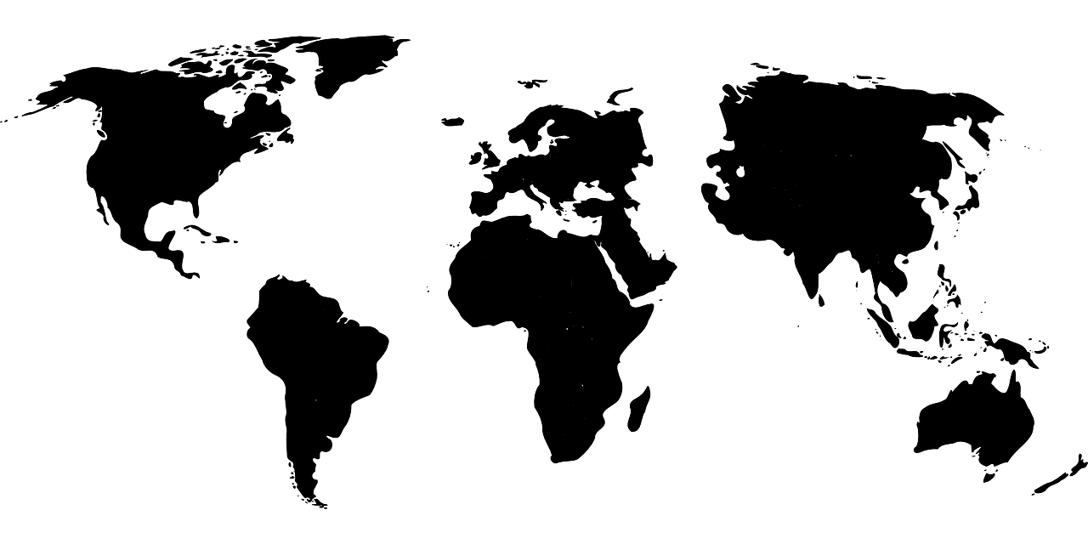
Nav’s Horizon Scan
2025–2035
Societal trends toward 2035 and consequences for the Norwegian Labour and Welfare Administration (Nav)

Slide 2
Contents
Introduction and summary
Contents
Scenarios
Perspectives from Nav employees
Demographics
Labour market
User expectations
Digital technology
Economic living conditions
Health
Political trends
Nav’s competence needs
Main findings and conclusion
Notes:
The Horizon Scan, published every second year, is an important tool to identify which trends and factors may be the most important for Nav leading up to 2035, what consequences these trends may have for us, and which trends are most uncertain.​
​
Because of the geopolitical situation, we have in this edition of the Scan a particular focus on possible impacts of changes in trade and tariffs and civil protection and emergency preparedness. ​
The Horizon Scan addresses a number of key trends and important factors for Nav. To develop a robust and efficient organization, we need to understand how trends and factors will affect each other; for example the links between the general trust in public services and how Nav can reach and serve people who need support. ​

Slide 3


Summary

Slide 4


Why does Nav need a Horizon Scan?
#1
#2
Reflection on and discussion of how societal trends will impact us
Basis for accurate strategies and priorities
Society is changing rapidly and in unpredictable ways. This Horizon Scan assesses which trends are most important for Nav and which are the most uncertain.
Nav employees are the primary target audience, but we also want to reach decision-makers and partners.

Slide 5
From vision of the future to effecting change
Set a course
Horizon Scan
Operational
strategy
Strategic priorities (3 years)
Annual budget and
targets and allocations letter
Effect change
Horizon Scan
The key societal trends
that are likely to affect the labour
and welfare area in the years leading
up to 2035, and the consequences
these may have for Nav
Strategy
Vision for Nav
(10 years) with four strategic objectives
Strategic priorities
Describe what Nav aims to achieve within three years. Updated annually and monitored with measurable success criteria
Annual budget and
targets and allocations letter
Annual priorities will be defined in targets and allocations letters issued at various levels in the public sector and will affect prioritisations in operating budgets

Slide 6

Main changes from the last Horizon Scan
Increased global insecurity
  Tense security situation and turbulence in global trade
  Democracies are under pressure, and we are also seeing changes in attitudes and values in Norway
Artificial intelligence is maturing as a technology
  Clearer applications in the labour market and for Nav, but new threats are also emerging
Clearer gap between user expectations for in-person and digital meetings and services
More vulnerable user groups and tight municipal finances increase pressure on social services
Photo: Microsoft stock images

Slide 7

New tools and presentation forms
New, interactive demographics tool provides better insight into local population developments
Six scenarios highlight positive and negative outcomes for uncertainties related to exclusion, user expectations and technology
Predictions for how economic development and the outcome of the trade conflicts may affect social services and the labour market
Nav’s employees have been asked both which trends may be important and which seem most uncertain leading up to 2035
Photo: Microsoft stock images

Slide 8
Societal trends and Nav toward 2035
Labour shortages, strong increase in demand for assistive technology and pensions
Increased demand for efficient and targeted services
Sustainable welfare policy
Geopolitical uncertainty and protectionism – must be prepared for abrupt changes in migration and labour market
Stronger focus on security and preparedness
2
1
Artificial intelligence plays central role in labour market and service development
Skills gap – unskilled workers most vulnerable
Better balance between digital services and personal assistance
Better health should lead to less demand for health benefits, but restructuring and mental health issues may increase it
Developments in immigration/integration is a main factor in social services
3
4

Slide 9

Central uncertainties for Nav
Global situation: War/conflict, trade barriers, tougher prioritisations
Consequences of artificial intelligence on the labour market and Nav
Level and composition of immigration
Development in mental health problems/disorders and consequences for exclusion
Photo: Unsplash

Slide 10







7 societal areas
Political
trends
01 Demographics
02 Labour market
03 User expectations
04 Digital technology
05 Economic living conditions
06 Health
07 Political trends

Slide 11
Scenarios

Slide 12

Inclusion and living conditions
Employment important for living conditions
We could fail if
High employment and good integration lead to good living conditions, and fewer children and youths will experience poor living conditions in childhood
Nav, the health care and education sectors, municipalities and employers contribute by working together on integration
We offer targeted education, lifelong learning and individual follow-up
Tight public budgets and limited capacity become barriers
Regional unemployment and low mobility lead to poor living conditions, mistrust and polarisation

Slide 13
User meetings
Users prefer digital solutions
We could fail if
Most prefer digital services and AI-supported tools
Clear prioritisation between standard solutions and personal assistance
Fewer Nav offices, but more expertise
High expectations and lack of prioritisation between user groups
Ineffective services and long wait times
Increased exclusion and growth of private services

Slide 14
Nav in the digital age
We could fail if
Lack of ICT expertise and digitisation-friendly regulations and funding
Outdated systems in parallel with new services leads to limitations in data sharing and high administrative costs
Low satisfaction and mistrust in the population
The public sector is leading
Efficient and user-friendly digital services
Secure cross-sectoral data sharing
AI used to provide guidance and case processing has been automated

Slide 15

Employee perspectives
New photo needed

Slide 16
Societal trends likely to affect Nav in the next 10 years, according to Nav emplyees

Slide 17
How uncertain do Nav employees believe these trends are?

Slide 18
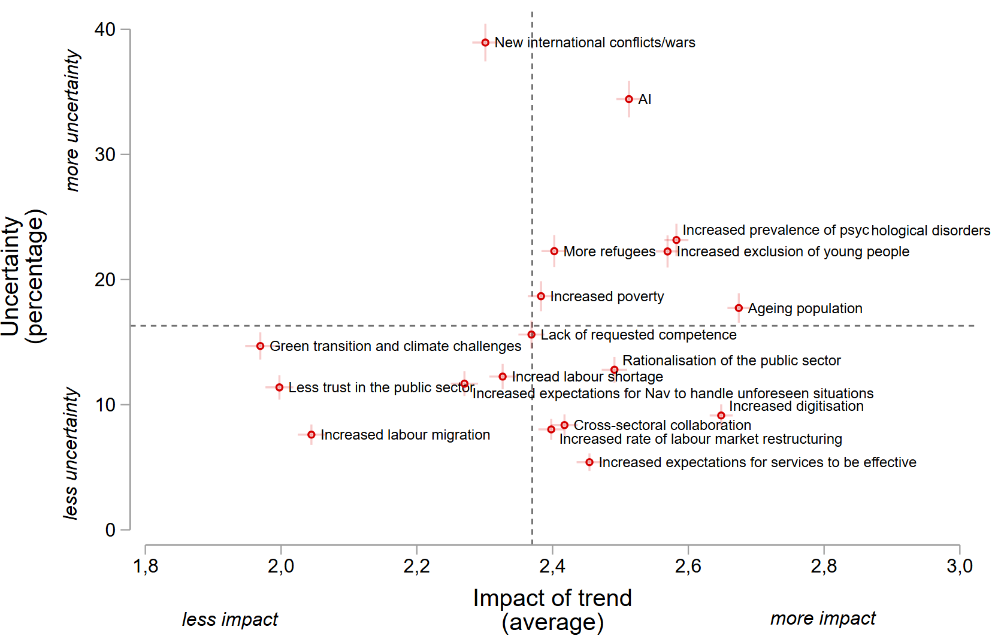
Which societal trends have both high uncertainty and high significance for Nav?
High uncertainty and low significance
High uncertainty and high significance
Low uncertainty and low significance
Low uncertainty and high significance

Slide 19
Familiarity with Horizon Scan and other knowledge sources within Nav

Slide 20
Employees believe the Horizon Scan both is useful and has the ability to influence Nav’s priorities

Slide 21

Demographics
Notes:
Norway’s population is expected to increase, from 5.6 million in 2025, to 5.9 million in 2035. Immigration has played a major role in Norway’s population growth in recent decades. We expect growth to slow in the years leading up to 2035. The growth in population will primarily be seen among the elderly. The population over 67 years old will increase by 24 percent, making up four fifths of the total population growth, whereas the number of children and young people will decrease. By 2035, we expect to have more people over 67 than under 18 in Norway. The working-age population (ages 20–66) is expected to increase by 3 percent.
The population growth will be strongest in centralised areas, whereas the districts will see depopulation and an ageing population. Small municipalities will be dependent on immigration for their population growth, and future immigration is associated with considerable uncertainty. Mpre than half of Norway’s municipalities could see a decrease in the working-age population (ages 20–66) by 2035. This Horizon Scan therefore presents a new demographics tool that will give Nav officers better insight into the local population.

Slide 22
Population, 2025 and 2035
Figures in 1,000 and changes in percentages
Consequences for Nav
Modest consequences for workload overall – 3 of 4 Nav employees work with users of working age
24-percent increase in users of assistive technology will be a challenge for Nav
Increasing gap between expenditures and revenues in the National Budget, which will lead to increased demands of efficiency in the public sector
Could lead to expectations of Nav providing employment-oriented follow-up to more user groups than today – which will require more counsellors at Nav offices
Age group 19–66
+3 %
Source: Statistics Norway population projection, mean alternative, June 2024

Slide 23


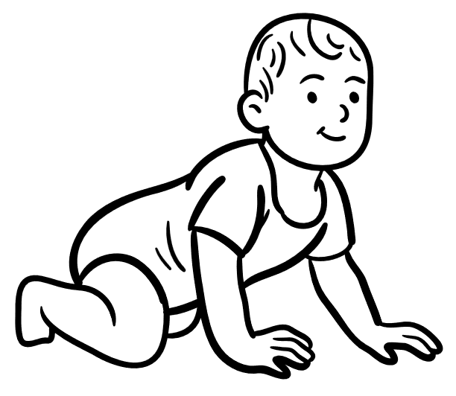
Population, 2025 and 2035
4 of 5 new citizens in the 67+ age group
+103,000
+225,000
-49,000
Age 0–19
Age 20–66
≥67 years
Source: Statistics Norway population projection, mean alternative, June 2024

Slide 24
Strong increase in pensions and assistive technology
Annual average for number of recipients (figures in 1,000) and change in percent, 2025–2035
Consequences for Nav
The population increase among the elderly means more pensioners and more demand for assistive technology
  Requires innovation to counter capacity challenges
  Pension reform in the public sector will increase number of old age pension recipients toward 2029
  More elderly people live at home for longer, increased demand for in-home adaptations
  Increased demand for workplace adaptations could further increase demand for assistive technology
Moderate growth in the number of recipients of family benefits
Source: Nav

Slide 25

Lower net immigration, climate change, war/conflict and labour shortages mean increased uncertainty
Photo: Pixabay
Source: Statistics Norway population projection, mean alternative, June 2024

Slide 26
Strongest increase in centralised municipalities
2025–2035
Consequences for Nav
Centralisation continues
Competition for labour:
  Regions with rapidly ageing populations will face labour shortages
  Also applies to recruitment to Nav and local partners
Reduced demand for Nav services in municipalities with a shrinking working-age population
Figures in parentheses show population in millions for each category of municipalities
Source: Statistics Norway population projection, mean alternative, June 2024

Slide 27
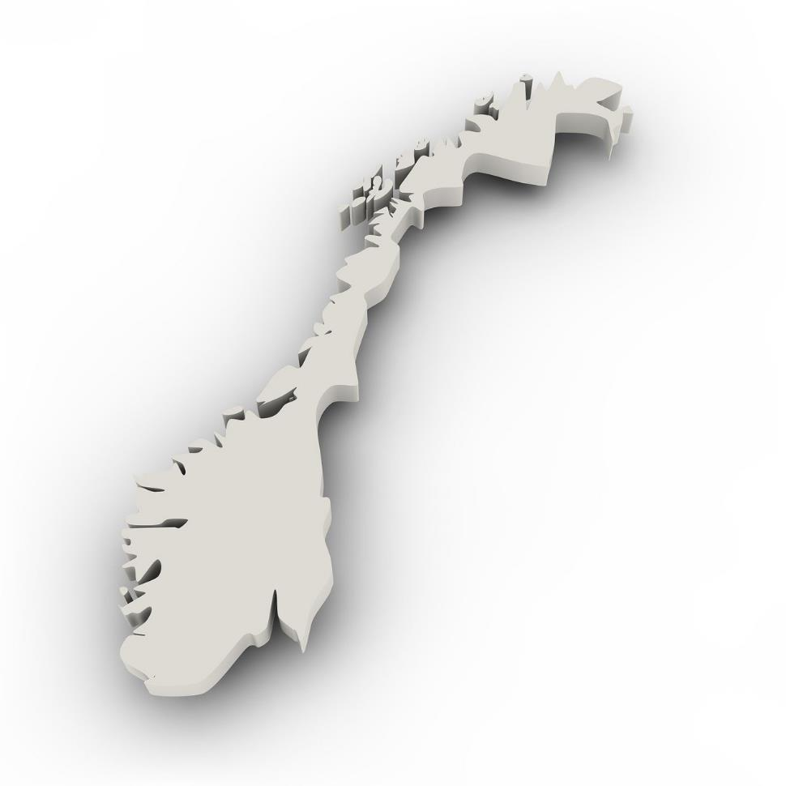
When will the number of old people (age 65 and up) surpass the number of young people (age 0–19) in each county?
Innlandet | 2019
Nordland and Telemark | 2022
Vestfold | 2026
Østfold, Møre and Romsdal and Troms | 2027
Buskerud and Finnmark | 2028
Trøndelag | 2031
Agder and Vestland | 2032
Akershus and Rogaland | 2038
Oslo | 2046

Slide 28

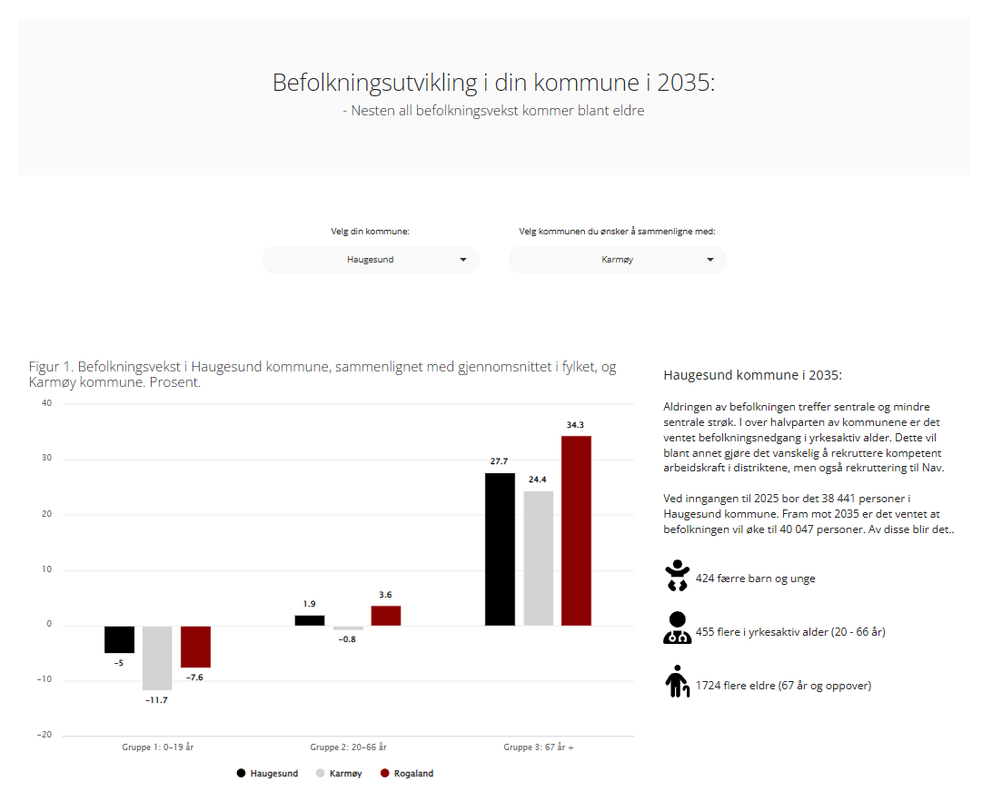
New demographics tool
Improved insights into local population developments
Try the tool here!
We also recommend Fremtids-verktøyet 2040 from KS

Slide 29

Labour market
Notes:
Norway has high employment rates and low unemployment compared to most other countries. We do, however, have a considerable share of the population that is not part of the labour force or pursuing an education, especially for health-related reasons. Lower educated people are over-represented among the unemployed and others outside the labour force, and we expect this to become even more prevalent by 2035. The government has defined a goal to increase employment rates in the 20–64 age group, from 80.5 percent in 2023 to 82 percent in 2030 and 83 percent by 2035. Labour shortages will yield better opportunities for workplace inclusion in the years to come.
Heading toward 2040, the demand for labour, especially in the health sector, will increase due to our ageing population. The number of people who pursue an education in healthcare is not high enough to meet this considerable demand. By 2040, we expect to see a shortage of 30,000 nurses and 24,000 health workers. We also expect to see a shortage of qualified workers in industry, construction and trades. This means we have to mobilise the part of our working-age population that is currently not part of the labour force, while simultaneously tackling changes in skill demand.

Slide 30

Labour market toward 2035
Labour shortages
Changes in skill demands
Protectionism and geopolitical uncertainty
Photo: Microsoft stock images

Slide 31
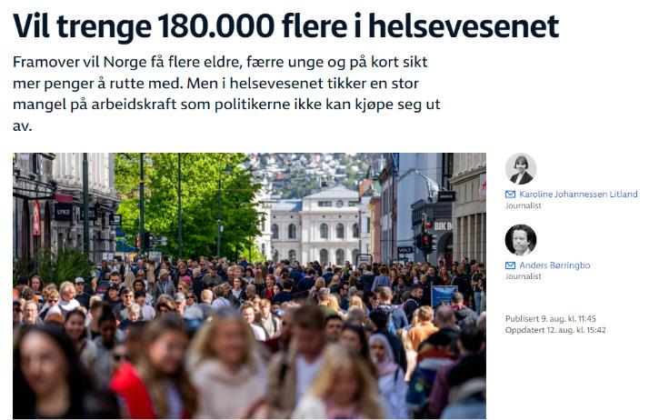
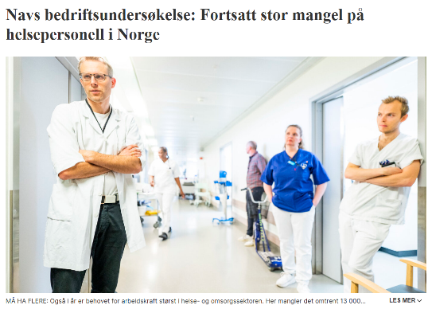
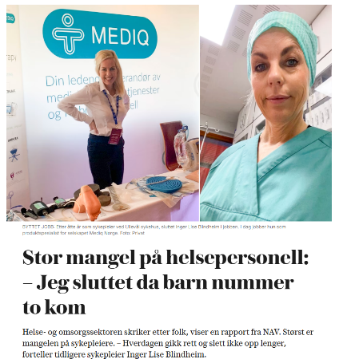
Ageing leads to labour shortages
Considerable shortage of health personnel
  2025: Shortage of approx. 11,000
  Shortage of 30,000 nurses and 24,000 health workers by 2040
Also shortage of workers with trade certification
Good opportunity for including more people who are outside the workforce

Slide 32

Technological development
9 % of jobs in OECD countries have a high proportion of automatable tasks. Norway less at risk than many other countries
Lower educated workers are most vulnerable
Net effect of job creation and job loss is uncertain, but likely positive
AI may boost productivity and provide new opportunities
  Estimates range from 0.5 % to 9 % in the next decade
Photo: Microsoft stock images

Slide 33

Increasing exclusion among unskilled workers
Share of population aged 20–66 not in education, employment or training
Source: Statistics Norway
Photo: Colourbox

Slide 34

Reduced employment in the oil and gas industry
Expansions in ocean wind energy, hydrigen and battery production
  Profitability challenges and global uncertainty affect the pace of the green transition
Nav can facilitate restructuring and competence-building
Green transition
Reduced employment in the oil and gas industry
Expansions in offshore wind energy, hydrogen and battery production
  Profitability challenges and global uncertainty affect the pace of the green transition
Nav can facilitate restructuring and competence-building
Photo: Microsoft stock images

Slide 35

An uncertain world
Trade conflicts and geopolitical unrest leads to uncertainty
  Affects exports and could reduce growth
Increased European self-sufficiency could also create opportunities
  Increased investments and defence spending
  More regional trade, could lead to new industrial growth
Photo: Microsoft stock images

Slide 36

Focus on skills
Shift resources to lifelong learning and competence development
Counselling should focus on educations and careers with good opportunities
Improved collaboration between Nav, the educational sector and employers
Photo: Pixabay

Slide 37



Scenarios for outcomes of the global trade conflicts
Return to status quo
Negotiations largely successful, conflict reduced
Tariffs eventually returning to previous levels
Trade virtually unchanged
Minor consequences for global economy
No extraordinary measures within Nav, but must be able to respond quickly if necessary
Minor reduction in exports, reduced investments and reduced growth
Minimal impact on unemployment, but restructuring between industries
Increased focus on restructuring, somewhat increased need for income protection
Tariffs remain
The announced tariff levels are maintained,
but not escalated further
Escalating trade war and global recession
Economic uncertainty affects operations and investments
Trust is undermined
Negative spiral: Reduced growth, price of oil drops, insolvency increases
Increased unemployment in export-dependent counties
Nav must increase capacity for processing and follow-up
Increased need for crisis management
Notes:
A new world order with considerable insecurity in international trade and geopolitics could lead to greater fluctuations and transitions in the labour market. We have therefore defined some main pathways for the development of trade and what effects these may have on the Norwegian economy and in particular for Nav. Abrupt changes in the labour market can imply significant changes in the need labour market services, benefit handling and in a severe crisis also need of social assistance. We need to be prepared.

Slide 38

User expectations
Photo: Pixabay
Notes:
Nav’s main user groups are private individuals and employers. Users have a clear expectation of being met with respect and trust. Even with the increased digitisation we expect to see by 2035, in-person communication and easy access to Nav remain the clear expectation. This is especially true in the early stages of processing and follow-up.
Users want simple, more cohesive and personalised services, both within Nav and across all public services. This includes both digital and in-person communication with Nav. We believe Nav will face a gap in expectations in the years to come, where we, on the one hand, must meet society’s expectation of automation and efficient resource utilisation, and, on the other, the users’ expectations of personalised services and close, long-term follow-up. The challenge is finding the right balance between digital services and person-to-person communication.
Employers are focused on labour shortages, especially in the districts, as well as increased demand for workplace adaptation. There is an expectation for Nav to maintain a long-term perspective in its follow-up of users to ensure more people have the skills and qualifications demanded by the labour market.

Slide 39
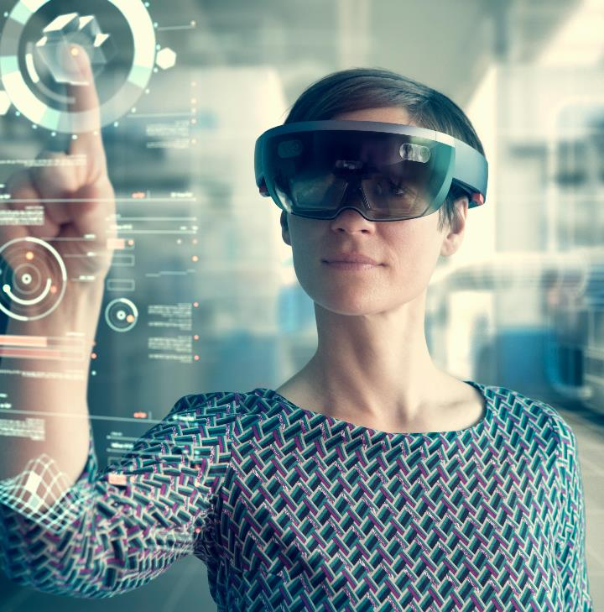
Technological developments shape expectations
Merging the digital with the analogue
Digitisation and new technology: Barriers and opportunities
(Digital) generational change?
Photo: Microsoft stock images

Slide 40

Reduced employment in the oil and gas industry
Expansions in ocean wind energy, hydrogen and battery production
  Profitability challenges and global uncertainty affect the pace of the green transition
Nav can facilitate restructuring and competence-building
Personal users and employers share the same expectations
Cohesive services across the public sector
More targeted inclusion in the workforce and long-term plans
Photo: Colourbox

Slide 41

Personal user expectations
Expectation of being seen as a whole human being, in the encounter with both services and employees within Nav
  More thoughtful interaction between digital services and personal assistance
  New technology can be inclusive, but can also create new barriers
  Need for relational competence
Personalised services
Co-determination at all levels
Photo: Microsoft stock images

Slide 42

Expectation gaps and dilemmas toward 2035
Simplification, automation and a more efficient Nav that does not spend too much of taxpayer's money
Personalised services and follow-up, person-to-person interactions

Slide 43

Employer expectations
Facilitation for inclusion
  Nav has knowledge of the local labour market and takes a long-term approach to meet needs
Presentation of opportunities and prevention of sickness absences
Photo: Pixabay

Slide 44

Digital technology
Notes:
Technology and society have a mutual influence on each other. Increased use of digital technology and artificial intelligence creates new opportunities for a more efficient public sector and the development of better services in line with user expectations. To meet expectations of more cohesive public services, the public sector must become better at utilising its own data and the data of others to revitalise and improve services. This requires a closer and more systematic collaboration between different public authorities.
We expect artificial intelligence (AI) to play a central role in digitisation in the next decade, including the use of generative AI models capable of handling text, images, audio and video. For Nav, we expect AI to become increasingly integrated into support tools that can ease the workload for Nav’s employees, and for this technology to provide decision support in processing and the assessment of follow-up needs. AI can also help promote universal design and contribute to the development of new assistive technology. Various technologies, such as situational audio description and live transcription, can assist users with visual and auditory impairment. Digital interpretation services can support communication in minority languages. AI can also be used to improve job application processes and recruitment. All exploration, development and use of AI in Nav must be handled responsibly and in line with data protection and security requirements to ensure high-quality services for all.

Slide 45






INTERNAL
Automated and driverless
Melding of the physical and digital
Technology trends
toward 2035
Quantum computers
Green transition
Personalised
medication
Commercial space travel

Slide 46

Melding of the physical and digital
Mixed reality
New ways of communicating and meeting
Opportunity to practice challenging situations
  Work training
  Guidance
Limited applications as of yet
Photo: Pixabay

Slide 47

One common thread...
Artificial intelligence
and generative models
Photo: Pixabay

Slide 48
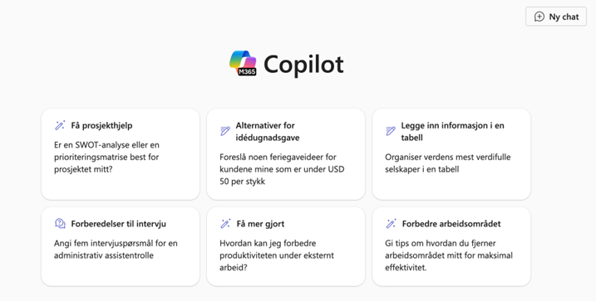
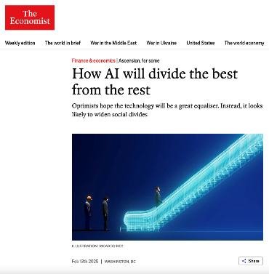
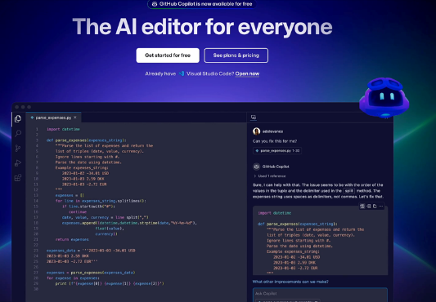

Artificial intelligence seeps into tools we use every day
Eases workloads
Lowers threshold for programming, image editing, plain language/translation, analyses
Will AI erase or exacerbate differences?

Slide 49

Artificial intelligence in Nav
Current/coming examples
  “Librarian” for counsellors at the Nav Call and Service Centre
  Privacy protection
  Improved job listings
  Minute transcriptions
  Coding assistant
Future opportunities
  Decision support in case processing and assessment of follow-up needs
  New tools and improvements in universal design
  Translation, interpretation and multilingual communication
  Learning modules and courses
Photo: Microsoft stock images

Slide 50
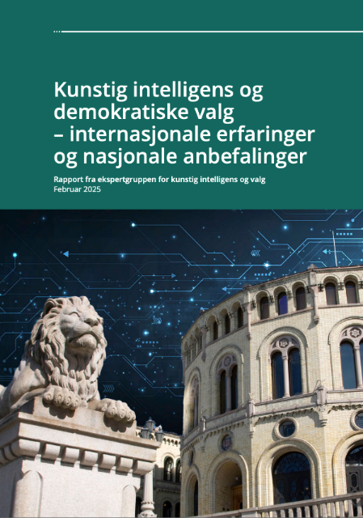
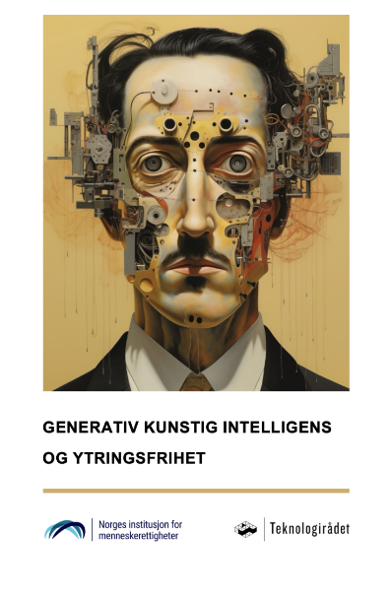
Digital vulnerabilities – disinformation, fraud, cyber attacks
False identities
Fake news
Forged documents
Smear campaigns
False websites and reports

Slide 51
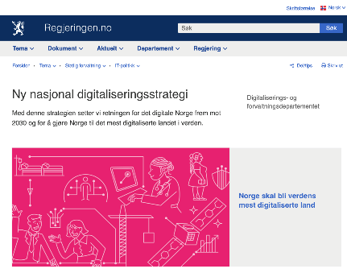
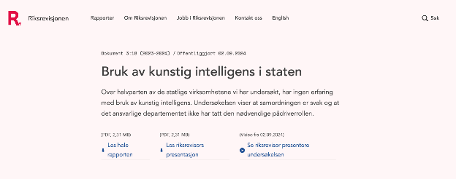

Conditions for digitisation
Digitisation strategy:
80 % of government undertakings will implement AI by 2025 – all by 2030.
Potential applications: Automation of routine tasks, decision support, risk and deviation analysis, resource allocation, user personalisation.
Office of the Auditor General:
“Few examples in the public sector where AI produces significant benefits, vast untapped potential”

Slide 52

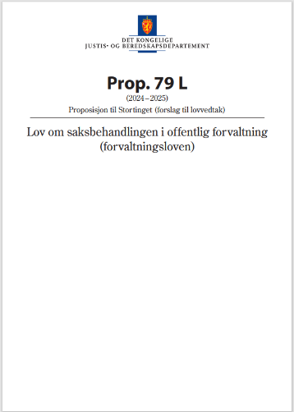

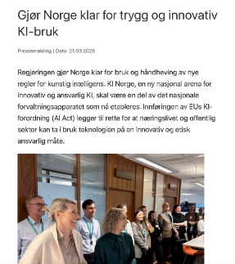
Legal constraints

Slide 53




The digitisation trends we have seen
before 2025...
How to digitise?
Financing models, best value for money
Access to expertise
Uncertainties in digitisation
How to get it right?
AI is predicted to have the same disruptive power that smartphones had, but there are legal and ethical risks
How to trust anyone?
The choice of digital tools could have
geopolitical and security implications
...are not necessarily the one that will dominate toward 2035

Slide 54

Economic living conditions
Notes:
Norwegian households have seen an increase in real income since the mid-1990s, but price inflation and higher interest rates since 2022 has put more households in a difficult financial situation. While the number of recipients of social assistance has increased overall, the percentage of Norwegian-born recipients of social assistance decreased up to 2023. In 2024 there was a small increase. Through this period, Nav has also seen an increase in the number of people who ask for help finding temporary accommodation. There has been a significant increase in the percentage of children who live in persistent low-income households (household income below EU60 for three consecutive years), and a lot of this increase can be attributed to immigration from Africa and Asia. Among immigrants from Africa and Asia, the employment rate is 62 and 65 percent, respectively, compared to 80 percent among Norwegian-born. The trend of increased child poverty seems to have slowed and perhaps reversed recently, including as a result of multiple increases in child benefit and removing child benefit from the calculation basis for social assistance. These policy changes have contributed to higher incomes for families who receive social assistance.

Slide 55

Incomes increased for all groups, but levelled off over last decade
Photo: Colourbox

Slide 56

Fewer Norwegians with strained finances than in the EU, but increase after 2020
Number of people who report that it is difficult/very difficult to make ends meet
Photo: Microsoft stock images

Slide 57

Tight finances most common in family-building phase (age 25–44)
Number of people who report that it is difficult/very difficult to make ends meet
Photo: Microsoft stock images

Slide 58

Recently arrived refugees have the biggest impact on social assistance
Recipients of social assistance by background
Photo: Colourbox

Slide 59
Scenarios for economic development
and need for social assistance
Stable economy
Low unemployment
High employment
Moderate real wage growth
High, but sinking interest rates
Trade conflicts force restructuring
Periodically high unemployment
Continued high inflation and interest rates
Low real wage growth
Economic setback
Global recession leads to serious decline
Significantly increased unemployment
Reduced property values
Stable or slightly reduced need for social assistance, provided the influx of refugees continues to abate
Moderate increase in need for social assistance
Significant increase in need for social assistance
Notes:
Unemployment rates, economic growth and developments in real income, debt-to-income ratios and interest rates, and the influx of refugees are the main factors that will affect economic constraints for families and the need for social assistance toward 2035. The most likely scenario is that unemployment rates remain low, employment rates remain high, and real income growth remains moderate. Refugees and other vulnerable groups will continue to need a certain degree of social assistance, but the main prediction is that the number of social assistance recipients will remain relatively low or decrease if the influx of new refugees continues to decrease. In addition, the ageing population will, on its own, reduce the need for social assistance, as pensioners rarely need social assistance.
If we see increased unemployment rates and the interest rates remain high, this will not immediately increase the demand for social assistance, but it will mean financial advice and counselling become more importan. If, on the other hand, we see a persistent situation with high unemployment, low real income growth and high interest rates, it could increase demand for supplementary financial assistance. The biggest individual factor with a potential to increase demand for social assistance is whether we will see a bigger influx of refugees again and how successful we are in integrating those come into our labour market.

Slide 60

What will influence living conditions and social services toward 2035?
Influx of refugees and integration
Unemployment and economic development: People with high debts are vulnerable
Policy changes, e.g. child benefit rates
Photo: Microsoft stock images

Slide 61

Health
Notes:
The burden of disease in the Norwegian population showed a marked decrease in the years 2000–2019, but increased again during the Covid pandemic. The pandemic continues to impact public health, by an increased prevalence of infectious diseases and sequelae from Covid-19. We expect to see a small increase in the burden of disease by 2035 due to the ageing population. Projections are uncertain. These uncertainties are tied, among other things, to the risk of new pandemics and increased antibiotic resistance, as well as potential refugee crises and negative consequences of climate and environmental changes.
The prevalence of mental health disorders in the population has been relatively stable for some time, and the projections do not predict any significant change by 2035. However, the share of people with self-reported mental health problems has increased among the young population, especially among young women. It is possible that this trend will continue, as it may be attributable to increased openness around mental health and an increased tendency to use health problems to explain social and/or complex issues

Slide 62

We live longer, but our healthy life expectancy does not increase quite as much
Photo: Pixabay
Source: Statistics Norway and Global Burden of Disease Project

Slide 63

Ageing increases burden of disease curve, but decrease in working age continues
Burden of disease, projected to 2035
(sum of lost life years + non-fatal health loss per 100,000 population)
Photo: Colourbox
Source: Global Burden of Disease Project

Slide 64
Mental health problems increasing – but psychological disorders are not
Burden of disease related to psychological disorders
(sum of lost life years + non-fatal health loss per 100,000 population)
Self-reported mental health problems have increased in the last decade
Primary health care service: Increase in inquiries related to psychological disorders and symptoms, especially ADHD and PTSD
Specialist health service: Slight increase in referrals for psychological and behavioural disorders
Source: Global Burden of Disease Project

Slide 65

Near historic peak for health-related benefits
Steady decrease
2010–2019
Increase during
and after pandemic
Still high in
2024–2025
(preliminary figures)

Slide 66

More young recipients (18–29) of health-related benefits, increased share receiving disability benefit
Photo: Microsoft stock images

Slide 67

Health – development toward 2035
Health-related benefits affected by more than health
  Labour shortages improve chances of inclusion
  Restructuring leads to increased risk of labour force exclusion
  Potential policy changes for benefits
  More targeted occupational follow-up
Uncertainties
  Risk of future pandemics
  Increasing antibiotic resistance
  Consequences of refugee and/or climate crisis
  Psychological disorders vs. mental health symptoms and problems
Photo: Pixabay

Slide 68
Work and health
Nav and health services. Need for concurrent and coordinated services for those who need help finding a job or remain in the workforce
Challenges include
Improve collaboration, information sharing and joint competence development
Joint models of service interaction
with Nav through “HelseIArbeid”
Specialist health services
with Nav through IPS
...with
Nav through “Samspill”
Municipal health services

Slide 69

Political trends
Notes:
In the years to come, Norway must adapt to changed and uncertain international trends. The war in Ukraine has had significant consequences for Norway, both in terms of our security policy specifically, and in terms of receiving and settling individuals who have been displaced by this war. There is considerable uncertainty associated with how many refugees and other displaced people will continue to come and with how many will remain here over time, both from Ukraine and other war zones. A significant shift toward defence and public security means that defence spending and other public support, e.g. to Ukraine, will make up a bigger part of the National Budget. Nav must be prepared for budgetary priorities changing and for preparedness plans and measures to become more of a focus.
Compared with most other countries, Norway enjoys a high level of trust, both within the population and between the population and public authorities. However, we see that polarisation is increasing and values in the population are changing in Norway as well. Many people have less faith in the government and the public sector being able to provide them with the support they need. There is a strong expectation that public resources can be utilised more efficiently. Social media is not well suited for a broad public discourse. It will therefore be important to achieve societal objectives, such as increasing employment rates, prevent workforce dropout, strengthen trust in national insurance and prevent areas of pervasive exclusion.

Slide 70

Influence of international political trends
International competition for qualified labour increases
Tense security situation
  Defence and security considerations lead to tougher prioritisation, as well as security and preparedness requirements for Nav
  Tariffs and trade restrictions
Resistance to environmental and climate policies, but climate problems are increasing
The EU is important for Norway
Photo: Pixabay

Slide 71
How to balance expectations for the welfare state with economic sustainability?
Reduce welfare state expenses
  Discussions of benefit offerings and rates, qualification requirements, activity requirements – and degree of active labour market policies
  Increased demand for efficiency. Simplified rules require a break from the trend of increasing complexity
Increase welfare state revenue
  Low willingness to pay taxes could lead to tighter political restrictions
Increase workforce participation
  Increased expectations for follow-up from Nav
  Focus on skills and inclusion
Share of population who support high taxes to preserve important public services
Source: Norsk Monitor (Ipsos)

Slide 72

Restructuring, skills and inclusion
More personalised education and lifelong learning, including in combination with work
Key role for training programmes through Nav
Measures for increased inclusion and integration of vulnerable groups – continued focus on exclusion among immigrants/refugees and young people
Increased demand for collaboration between Nav, employers, the educational sector and health services
Photo: Pixabay

Slide 73

Preparedness and public safety
Uncertainty – increased spending on defence and security leads to tough prioritisations
Increased requirements for preparedness within Nav
Cyber crime and hybrid warfare are increasing threats
Benefit fraud and work-related crimes require good collaboration
Photo: Pixabay

Slide 74
Shift in political values
Share of population who believe select issues are especially important
Defence and energy more important – climate, employment and research less important
Welfare model under pressure?
  Greater acceptance of social inequality and increasingly positive attitudes toward private solution than before
Norway has a high level of trust, but there are signs of change and increasing polarisation
Source: Norsk Monitor (Ipsos)

Slide 75

Nav’s competence needs
Notes:
Nav’s expertise must evolve to meet restructuring and developing competence requirements in the labour market, changed expectations from users, digitisation and increased collaboration with other services.
Restructuring in the labour market will require Nav to have up-to-date analytical knowledge and an understanding of what these changes mean for the labour market and for service development, on both a national and a local level.
Changes in user expectations will require better knowledge of user needs.
Cohesive services across sectors and administrative levels will require increased knowledge of partners in other sectors, which services can be offered to users, what the effects of such services are, and how new services can be developed in collaboration with others.
Digitisation and AI will affect all of Nav’s services and employees, and will require legal, technological and analytical knowledge and knowledge of how technology is used.

Slide 76
Future competence needs in Nav
Restructuring and competence gap
Changed user expectations
More cross-sectoral collaboration
Digitisation and AI
Analytical knowledge of consequences for the labour market and service development
Practical competence development, exchange of research and experience-based knowledge
Flexible and innovative service development
Knowledge of user needs
Overview of employee competence
Counselling competence and knowledge of how to promote inclusion of vulnerable groups
Communication and relational competence
Knowledge exchange with partners on user needs, service offerings and effects
Competence in interdisciplinary and cross-sectoral collaboration and joint development initiatives
Legal, technological and analytical competence
Competence in use of digital tools in user interactions
Competence in responsible use of services based on algorithms and artificial intelligence
Understanding of how digitalisation and AI will affect the labour market

Slide 77
Main findings and conclusion

Slide 78
Societal trends and consequences for Nav toward 2035
4/5 of increase in 67+ age group. Decrease in working-age population in half of the country’s municipalities
Uncertainty surrounding immigration
Increased demand for efficient and targeted services
25% increase in assistive technology and old age pension requires innovation
Responsible use of artificial intelligence (AI): Easing workloads, improved language and accessibility, decision support in case processing and follow-up, new tools
Increased digital vulnerability: Benefit fraud, cyber attacks, disinformation
Need for clarification of legal framework, digitisation-friendly regulations and discourse on governance and funding
Demographics
Technology
Labour shortages, especially among health personnel and skilled workers
Changes in skill demands due to restructuring and new technology
Protectionism and geopolitical uncertainty leads to unpredictability, but European self-sufficiency also creates opportunities
Good conditions for inclusion. Competence development and lifelong learning in collaboration with employers and the education sector
Large influx of refugees leads to increasing demand for social services
Developments in immigration/integration and the economic situation are key factors in the time to come.
Improved public health means fewer people receive health-related benefits
Risk of exclusion during transitions and increased prevalence of mental health problems among young people could bring numbers up.
Living conditions and health
Labour market
Stronger focus on defence and security leads to tough prioritisations
Increased requirements for security and preparedness within Nav
Sustainable welfare: Stronger focus on competence, inclusion and prevention of exclusion. Discussions about activity requirements, benefit levels, benefit structure and the degree of active labour market policies
High trust and low polarisation in Norway, but some indications this may change
Predictable income protection and long-term plans for inclusion
Cohesive and simple services, personalised to the individual
Expectation gap between efficiency and personalisation – requires systematic interaction between digital services and person-to-person meetings
User expectations
Political trends

Slide 79
Want to know more?
More information found here: nav.no/omverdensanalyse
You may also contact us via e-mail redaksjon.omverdensanalysen@nav.no

